Slide 1
Module 1:
Determinants of Health
Developed through the APTR Initiative to Enhance Prevention and Population
Health Education in collaboration with the Brody School of Medicine at East Carolina University with funding from the Centers for Disease Control and Prevention
Notes:
Today we are going to be talking about the determinants of health, factors that influence the health of both individuals and the community in which they live.

Slide 2
Acknowledgments
APTR wishes to acknowledge the individuals and institution that developed this module:
Lloyd F. Novick, MD, MPH
Department of Public Health
Brody School of Medicine at East Carolina University
Julie C. Daugherty, BS
Department of Public Health
Brody School of Medicine at East Carolina University
This education module is made possible through the Centers for Disease Control and Prevention (CDC) and the Association for Prevention Teaching and Research (APTR) Cooperative Agreement, No. 5U50CD300860. The module represents the opinions of the author(s) and does not necessarily represent the views of the Centers for Disease Control and Prevention or the Association for Prevention Teaching and Research.
Notes:
We are going to identify the leading causes of death, but also talk about the underlying causes of health and health disparities in the United States. We are going to describe the use of Healthy People objectives in Public Health program planning.

Slide 3
Presentation Objectives
Discuss the role of population-level determinants on the health status and health care of individuals and populations
Identify the leading causes of death, leading underlying causes of death, and health disparities in the United States
Describe the distribution of morbidity and mortality by age, gender, race, socioeconomic status, and geography in the United States
Describe the use of Healthy People objectives in public health program planning

Slide 4
Importance of Health Determinants
“Common diseases have roots in lifestyle, social factors and environment, and successful health promotion depends upon a population-based strategy of prevention.”
Rose 1992
Notes:
Common diseases have roots in lifestyle, social factors and the environment. Successful health promotion depends on a population based strategy of prevention.

Slide 5



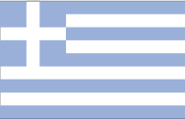


















Life Expectancy in Years by Country at Birth (2009 est.)
 | Japan | 82.12 |  | Norway | 79.95
 | Singapore | 81.98 |  | Greece | 79.66
 | Australia | 81.63 |  | Austria | 79.50
 | Canada | 81.23 |  | Netherlands | 79.40
 | France | 80.98 |  | Germany | 79.26
 | Sweden | 80.86 |  | Belgium | 79.22
 | Switzerland | 80.85 |  | United Kingdom | 79.01
 | Israel | 80.73 |  | Finland | 78.97
 | New Zealand | 80.36 |  | Denmark | 78.30
 | Italy | 80.20 |  | Ireland | 78.24
 | Spain | 80.05 |  | United States | 78.11
Notes:
Let’s look at this chart. The bottom right-hand corner shows the United States with a life expectancy shorter than that of other countries, other developed countries. This is despite the fact that the United States spends more on medical care than any of the other countries shown on the chart.

Slide 6
Adapted from McGinnis JM, Williams-Russo P, Knichman JR. The case for more active policy attention to health promotion. Health Aff (Millwood) 2002;21(2):78-93.
Notes:
This chart shows the impacts of various domains on early deaths in the United States. It shows that shortfalls in medical care only contribute 10% to premature death. Many of us think that our health is determined by our genes, or our DNA, yet this chart shows that genetic predisposition only counts for 30% of premature death. Looking at behavioral patterns, environmental exposure, and social circumstances, these factors add up to 60%, the major impact on early death in the United States. Now this chart is from an article that was published 10 years ago. If anything this chart underestimates the influence of social determinants and environmental determinants and behavioral patterns, and we will see that as we go through these factors, through these determinants in this presentation.

Slide 7
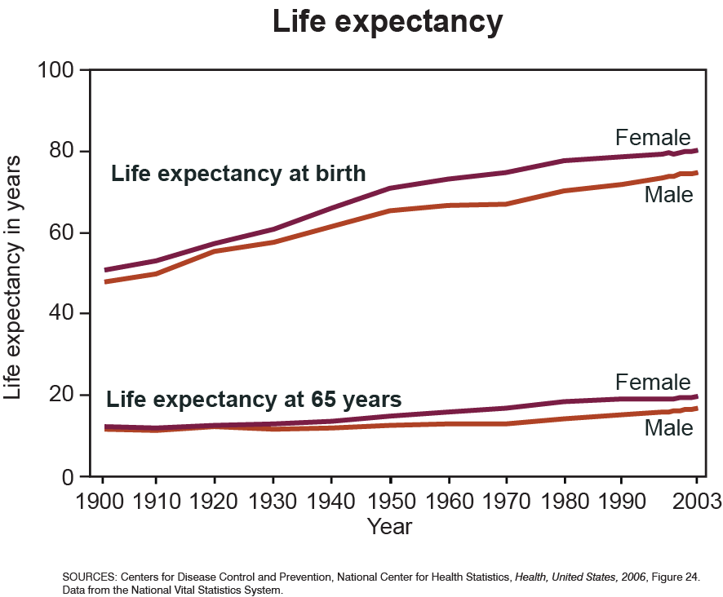
Notes:
It is instructive to look at life expectancy in the United States. Beginning in the early 20th century, now through the year 2003, you will note a gain in life expectancy of approximately 30 years. It is instructive to note that 25 of those years, the majority of this gain, can be attributed to advances in public health affecting the determinants we are going to be speaking about in this presentation. It’s also interesting to look at life expectancy at 65 years of age; you’ll see that there hasn’t been much of an increase from the early part of the 20th century to 2003.

Slide 8
Importance of Health Determinants
As health professionals, training and reimbursement systems emphasize diagnostic and treatment services to individuals.
We need to focus on those factors (DETERMINANTS) which have the most influence on the health of the population.
Rose 1992
Notes:
As health professionals our training and the reimbursement we get from diagnostic and treatment services emphasizes the treatment model in medical care activities. We need to focus on those factors or determinants which have the most influence on the health of the population.

Slide 9
Importance of Health Determinants
Focus on those determinants which have the most influence on the health of the population.
  Environment
  Social
  Biology
Current attempts at health reform will not be successful at improving health unless the population health determinants are addressed.
Notes:
When I state a focus on those determinants, which have the most influence on the health of the population, I am talking about environmental determinants, social determinants, and biological determinants. Current attempts at health reform will not be successful at improving health unless the population health determinants are addressed. In March of 2010, major legislation was enacted, the Patient Protect and Affordable Care Act, and that act contains many public health provisions, including reimbursement for clinical preventive services and also community wide initiatives to improve health.

Slide 10
1900: Ten Leading Causes of Death per 100,000 persons
2007: Ten Leading Causes of Death per 100,000 persons
Adapted from the MMWR Vol. 48, no. 29, 1999 Centers for Disease Control and Prevention and 2007 data from the National Center for Health Statistics
Notes:
Let’s examine the 10 leading causes of death in 1900 and compare them with causes of death, more recently in 2007. There is a marked variation in pattern, so that in the early part of the 20th century the leading causes of death were infectious disease, primarily tuberculosis. In 2007, the leading causes of death are chronic disease. That is not to say that infectious diseases are not important, particularly emerging infectious diseases such as HIV and the possibility of pandemic flu. But it does show you that the pattern is now chronic disease and as we will see, determined by the determinant of health behavior and the future health of our population and our efforts to improve it are going to be best addressed by working with behavioral determinants which are related as we will see to social determinants and environmental determinants.

Slide 11
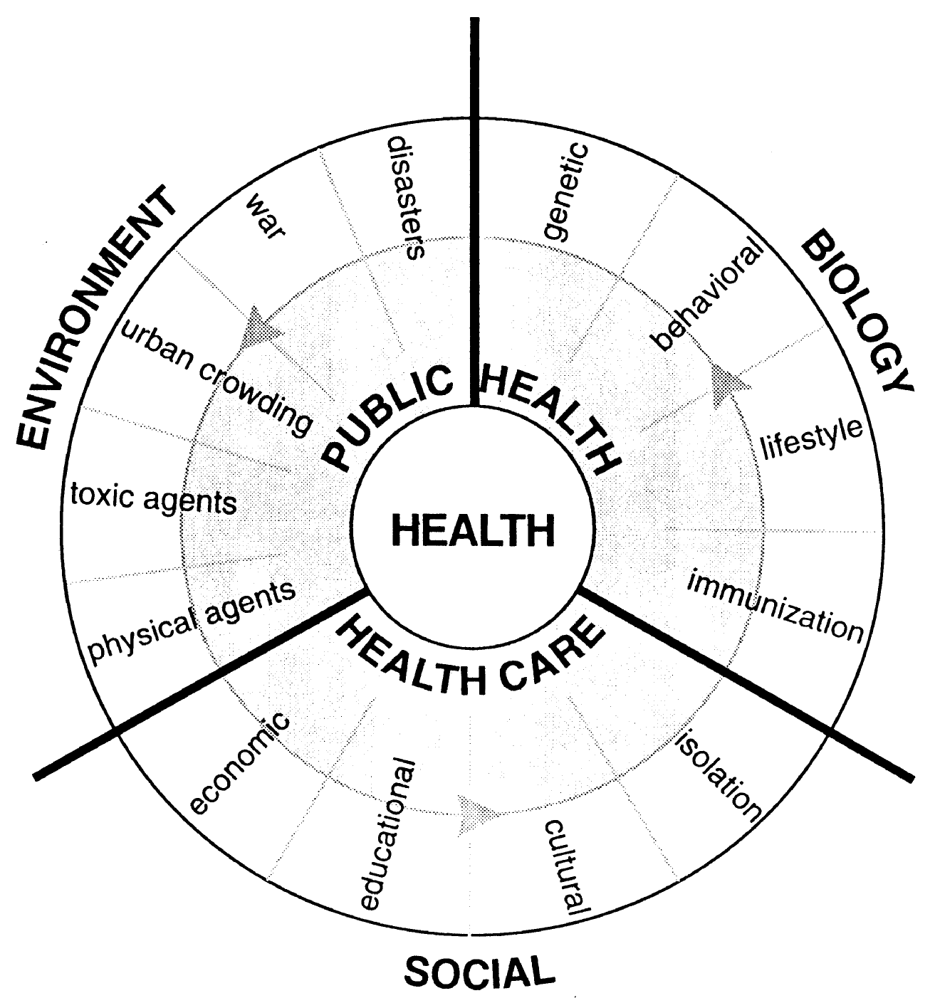
Determinants of Health
Novick, LF. Used with permission.
Notes:
This diagram shows the determinants of health: environment, biology, and social and how they all interact to determine the health of individuals and the communities in which they live.

Slide 12
Contemporary Concept of Health
Health has multiple determinants.
Factors important to health, illness, and injury are social, economic, genetic, perinatal, nutritional, behavioral, infectious, and environmental.
Omenn 1998
Notes:
As we have been discussing, health has multiple determinants. Factors important to health include social, economic, genetic, perinatal, nutritional, behavioral, infectious, and environmental.

Slide 13
Contemporary Concept of Health
Biologic or host factors include:
  genetics
  behaviors that determine the susceptibility of the individual to disease
  other factors related to susceptibility
Notes:
Biologic or host factors include genetics, behaviors that determine the susceptibility of the individual to disease and other factors related to susceptibility. For example, immunization removes susceptibility to vaccine preventable diseases including measles, mumps, and diphtheria. Other diseases such as HIV infection can increase susceptibility by decreasing immune response.

Slide 14
Environmental Determinants
Environment includes:
  physical environment
  conditions of living
  toxic agents
  infectious agents
Notes:
Environment includes physical environment, conditions of living, toxic agents and infectious agents.

Slide 15
Social Determinants
Social factors of importance include:
  poverty
  education
  cultural environments (including isolation)
Notes:
Social factors of importance include poverty, education, and cultural environments.

Slide 16
HIV Example
A contemporary example of the agent-host-environment model can be seen with the transmission of HIV in a community, which is determined by:
  infectious agent
  host individuals
  environment
The agent-host-environment model facilitates public health intervention because disease can be interdicted by addressing any one of these factors
Notes:
Let’s use the example of HIV. This is an excellent example of the agent-host-environment model, which explains the transmission of HIV in a community and explains which individuals become infected with HIV. This is dependent on the infectious agent, the host or individual, and the environment. The agent-host-environment model is a public health model. It’s important because disease can be stopped by addressing any one of these factors. So, for HIV, we do not have a vaccine that prevents it, we do not have a treatment that cures the disease, but we can still prevent the disease.

Slide 17
Occurrence
Environment
Individual
Agent
Information
Education
Peer norms
Drug use
Condom availability
Sexual behaviors
Condom utilization
Multiple partners
Intravenous drug use
Prevention
Environment
Individual
Partner notification/ Needle exchange/ Safe sex/ Condoms
Agent
Used with permission.
Notes:
Let’s take a look at this diagram. The occurrence of HIV, as I have explained, is dependent upon the interaction of the environment, the individual or host, and the agent. For the individual, the following is important: sexual behaviors, multiple partners, intravenous drug use, condom utilization. For the environment: what are the peer norms, what information and education is available, how much drug use there is in the environment, and what is the availability of condoms in the environment. Now, let’s look over to the right side of this diagram, this is the prevention model. By simply splitting the agent from the environment and the individual, we can prevent the disease. This is what we are doing with mechanisms such as partner notification, needle exchange, safe sex practices, and the use of condoms.

Slide 18
Tuberculosis
What is the cause of TB?
What explains the decrease in TB from 1900 to the present?
The answer to both of these questions is related to the multiple factors that cause TB.
Notes:
Another example of what we are talking about is tuberculosis. What is the cause of tuberculosis? Is it mycobacterium tuberculum? That’s the agent, but the agent does not explain the occurrence of tuberculosis unless we also consider the host and the environment. This is shown by an examination of the decrease in TB from 1900 to the present.

Slide 19
Tuberculosis
Used with Permission, Lienhardt 2001
Notes:
Let’s look at this graph. We see a sharp decrease in the occurrence of TB since mid 19th century to mid 20th century. This is not because of the advent of antibiotics that can treat the infectious agent, although they certainly helped at the tail end of this decrease, with the advent of Streptomycin in 1948. Actually, the decrease can be explained by changed in social factors and the environment, namely, decrease in crowding since the mid 19th century.

Slide 20
Used with permission, Lienhardt 2001
Notes:
This next diagram shows the multiple factors that explain the occurrence of TB. We know that individuals can be exposed to the TB agent. The next step is a primary infection and from the primary infection, some individuals will actually develop actual active TB, primarily of the pulmonary type. But the actual factors that explain the development are not simply the agent. They include socioeconomic factors such as poverty and its relationship to alcoholism, crowding in homeless shelters and prisons, and urbanization. Other factors that affect the susceptibility of the host are also important and this includes HIV infection, which can accelerate development of the disease for individuals who already have the primary infection.

Slide 21
Determinants of Health
Social
Novick, LF. Used with permission.
Notes:
Returning to our diagram, we will now look in more depth at the social determinant.

Slide 22
The Socioeconomic Determinant
2003 Institute of Medicine report concludes Americans today “are healthier, live longer, and enjoy lives that are less likely marked by injuries, ill health, or premature death”
Gains are not shared fairly by all members of society
  Widening gap between upper and lower class
IOM 2003
Notes:
A 2003 Institute of Medicine report concludes that Americans today are healthier, live longer, and enjoy lives that are less likely marked by injuries, ill health, or premature death, but these gains are not shared fairly by all members of society.

Slide 23
The Socioeconomic Determinant
Elevated death rates for the poor are evident in almost all of the major causes of death and in each major group of diseases, including infectious, nutritional, cardiovascular, injury, metabolic, and cancers.
Wilkinson, 1997
Notes:
Elevated death rates for the poor are evident in almost all of the major causes of death and in each major group of diseases, including infectious, nutritional, cardiovascular, injury, metabolic, and cancers.

Slide 24
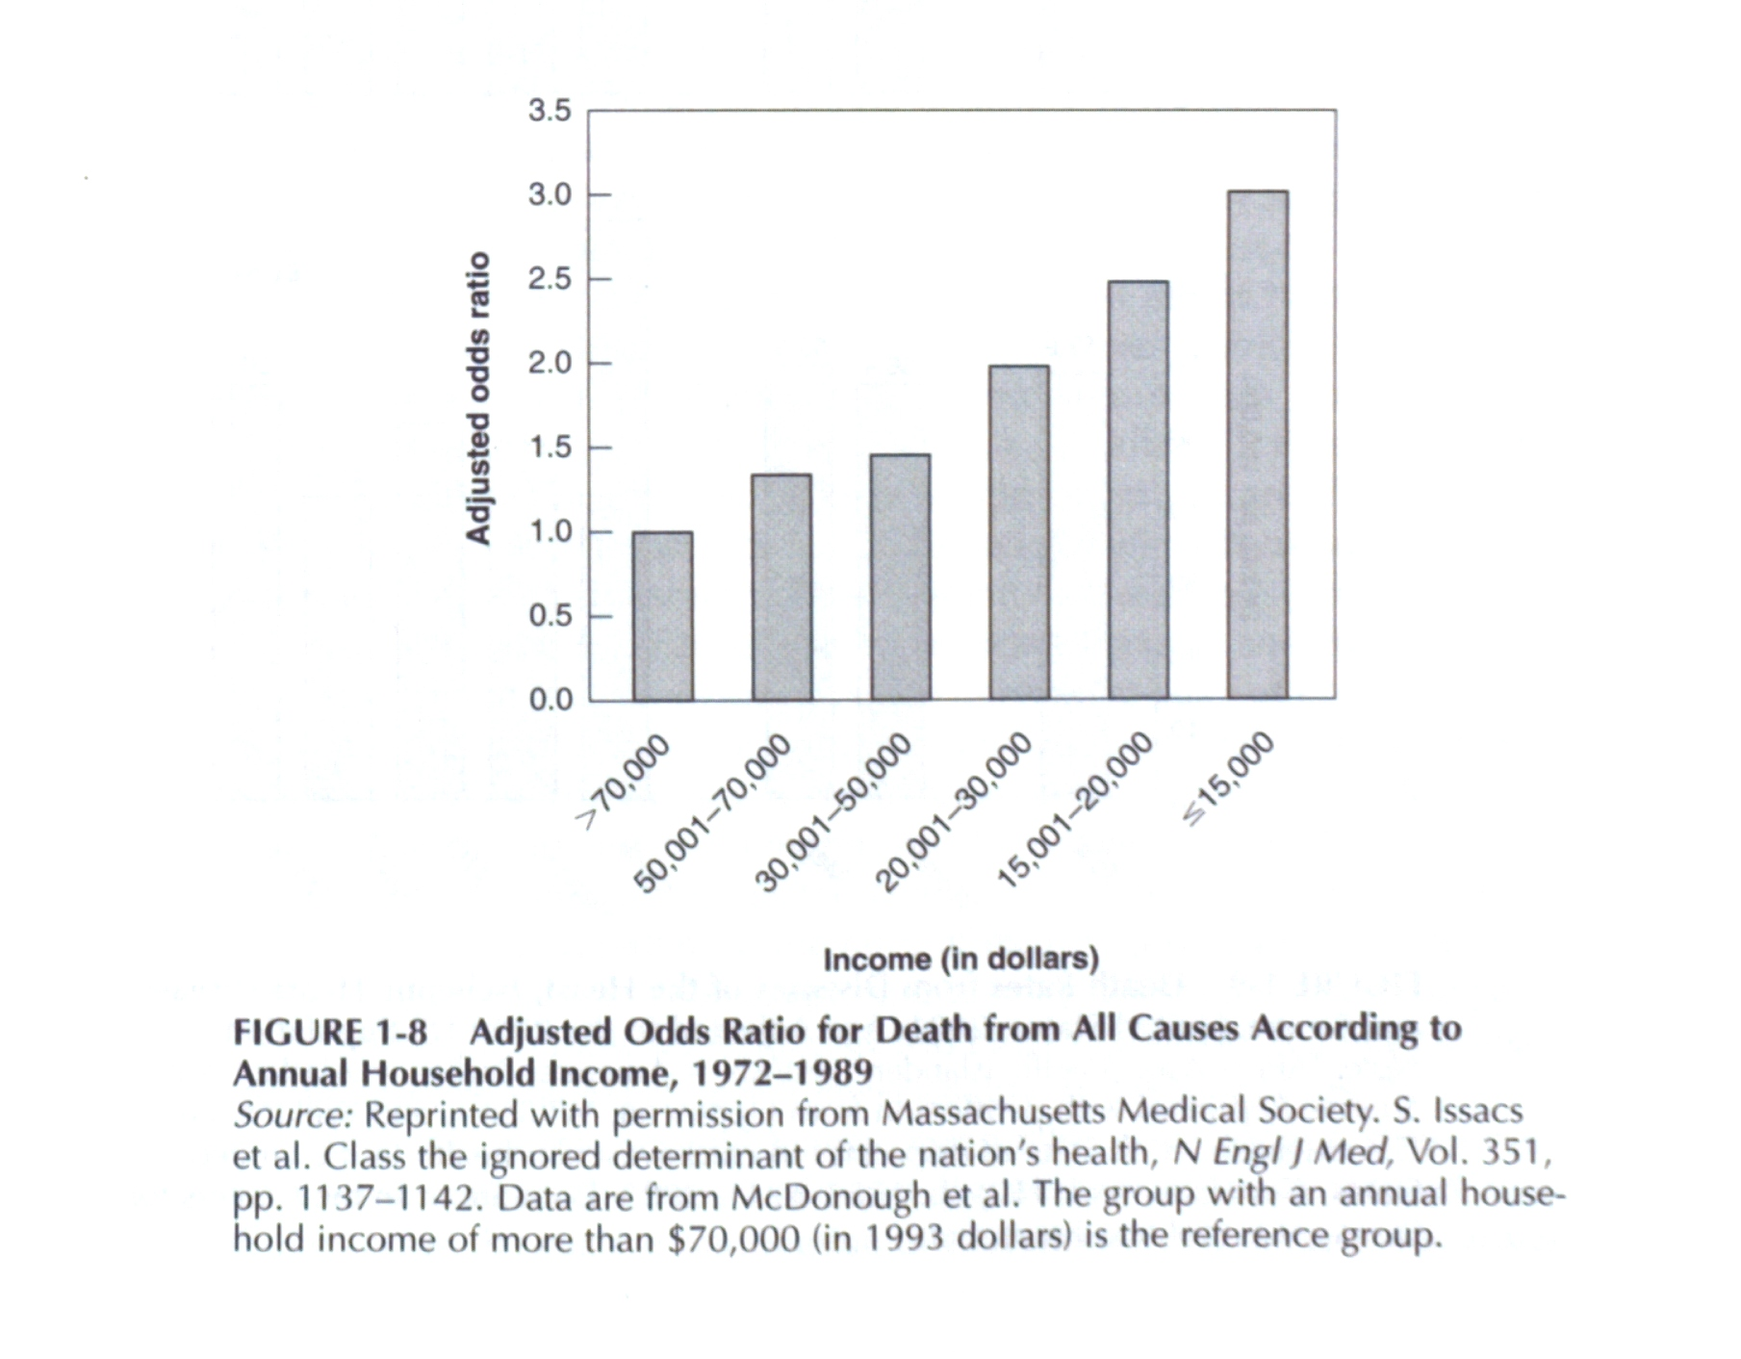
Used with permission.
Notes:
Let’s look at this chart and look at the risk of death from all causes according to annual household income, and the risk increase with decreasing income.

Slide 25
Socioeconomic Factors and Disparity
Heart disease is the leading cause of death in the United States and is one of the areas in which disparities are most evident.
Notes:
Heart disease is the leading cause of death in the United States and is one of the areas in which disparities are most evident.

Slide 26
Prevalence of Heart Disease (per 1,000 persons) among persons 18 years of age and over, by Family Income
Adapted from Summary Health Statistics for U.S. Adults: National Health Interview Survey, 2008, Series 10, Volume 242, December 2009
Notes:
This chart shows that the occurrence of heart disease is the highest for individuals with an income of less than $35,000, decreasing sharply for individuals who have an income of $100,000 or more.

Slide 27
Socioeconomic Factors and Disparity
The Whitehall I Study, a long-term follow-up study of male civil servants, was set up in 1967 to investigate the causes of heart disease and other chronic illnesses.
Researchers expected to find the highest risk of heart disease among men in the highest status jobs; instead, they found a strong inverse association between position in the civil service hierarchy and death rates.
Wilkinson 2009
Notes:
The Whitehall Study was a long-term follow-up study of male civil servants in England that investigated the causes of heart disease and other chronic illnesses. Researchers expected to find the highest risk of heart disease among men in the highest status jobs. They thought that men in high status jobs would be subject to the most stress.

Slide 28
Socioeconomic Factors and Disparity
Men in the lowest grade (messengers, doorkeepers, etc.) had a death rate three times higher than that of men in the highest grade (administrators).
Further studies in Whitehall I, and a later study of civil servants, Whitehall II, which included women, have shown that low job status is not only related to a higher risk of heart disease: it is also related to some cancers, chronic lung disease, gastrointestinal disease, depression, suicide, sickness absence from work, back pain and self-reported health.
Wilkinson 2009
Notes:
What they found was the opposite. Men in the lowest grade such as messengers had a death rate three times higher than that of men in the highest grade. Further studies, which have included women, have shown that low job status is not only related to a higher risk of heart disease; it is also related to some cancers, chronic lung disease, gastrointestinal disease, depression, suicide, sickness absence from work, back pain, and self-reported health.

Slide 29
Relative Rates of Death from Cardiovascular Disease among British Civil Servants according to the Classification of Employment
Notes:
This chart shows the relative rates of death from cardiovascular disease among British Civil Servants according to the classification of employment. So, the lowest rate is found in the administrative classification. Next lowest is the professional or executive and it increase for clerical and other workers.

Slide 30
Regional Convergence of Social Issues
Percent Poverty 2005¹
8.3% - 13.2%
13.3% - 16.2%
16.3% - 20.2%
20.3% - 32.0%
Percent Uninsured 2005²
13.4% - 17.0%
17.1% - 18.6%
18.7% - 20.6%
20.7% - 27.5%
Notes:
1. US Census estimates on poverty
for 2005 with 90% CIs. Interpret
with caution. Accessed
http://www.census.gov on 5-16-08.
2. Sheps Center (UNC) estimates of those
without health insurance for 2005.
Accessed http://www.shepscenter.unc.edu
on 5-16-08.
3. Based on calculations from ECU’s CHSRD
(using data from The Odum Institute, UNC).
Years of life lost before the age of 75.
Premature Mortality³
2002-2006
Low
553 - 797
797 - 878
878 - 977
977 - 1250
High
James Wilson, PhD
Center for Health Services Research and Development
East Carolina University
Greenville, NC.
Notes:
30
This map is of North Carolina. It shows a regional convergence of social issues. Let’s look at the bottom of the map. Those counties with the highest premature mortality are shown in brown. Now let’s go one up, look at the middle map. This shows the percentage of uninsured, the highest percentages are shown in dark brown. These counties look very similar in pattern to the first map we looked at of premature mortality. Then, let’s go to the top map, which is percent poverty. The highest counties with percent poverty are shown in dark blue, so what we are essentially seeing here, is we are seeing the same maps that we are seeing the premature mortality and percent poverty are occurring in the same locations. And a partial explanation of this, is the percent uninsured.

Slide 31
Income & Health
In the United States, individuals without a high-school diploma as compared with college graduates are 3X as likely to smoke and nearly 3X as likely not to engage in leisure-time physical exercise
Pratt et al. 1999
Notes:
In the United States, individuals without a high-school diploma as compared with college graduates are three times as likely to smoke and nearly three times as likely not to engage in leisure-time physical exercise.

Slide 32
Income & Health
As a result of a sedentary life-style and unhealthy eating habits (often as a result of conditions in which wholesome food is unavailable or exorbitantly priced, public recreation is non-existent, and exercising outdoors is dangerous), obesity and the diseases it fosters now characterize lower-class life.
Notes:
As a result of a sedentary life-style and unhealthy eating habits, often as a results of conditions in which wholesome food is unavailable or highly priced, and public recreation is non-existent, and exercising outdoors is dangerous, obesity and the diseases it fosters now characterize lower-class life.

Slide 33
Income & Health
Poor neighborhoods
  often dangerous
  high crime rates
  substandard housing
  few or no decent medical services nearby
  low-quality schools
  little recreation
  almost no stores selling wholesome food
Offer residents, no matter what their race, income or education, little chance to improve their lives and engage in health-promoting behaviors.
Diez et al. 2001
Notes:
Poor neighborhoods are important for the reasons outlined on this slide. They are often dangerous, high crime rates, substandard housing, little recreation, almost no stores selling wholesome food.

Slide 34
Income & Health
People of lower socioeconomic status are more likely to die prematurely than are people of higher socioeconomic status, even when behavior is held as constant as possible.
Notes:
People of lower socioeconomic status are more likely to die prematurely than are people of higher socioeconomic status, even when the behavior is held as constant as possible.

Slide 35
Understanding how Income Influences Health
Inequitable distribution of income and wealth may itself cause poor health.
Daniels et al. 2000
Notes:
How does income influence health? Inequitable distribution of income and wealth may itself cause poor health.

Slide 36
Socioeconomic Factors and Disparity
Life expectancy appears to be more related to income inequalities than to average income or wealth.
In a study of the relationship between total and cause-specific mortality with income distribution for households of the United States, a Robin Hood index measuring inequality was calculated and found to be strongly associated with infant mortality, coronary heart disease, malignant neoplasms, and homicide.
Wilkinson 1989, Kennedy et al. 1996
Notes:
Life expectancy appears to be more related to income inequalities than to average income or wealth. In a study of the relationship between total and cause-specific mortality with income distribution for households of the United States, a Robin Hood index measuring inequality was calculated and found to be strongly associated with infant mortality, coronary heart disease, malignant neoplasms, and homicide.

Slide 37
Socioeconomic Factors and Disparity
Despite decreases in mortality, widening disparities by education and income level are occurring in mortality rates. Mortality rates for children and adults are related both to poverty and to the distribution of income inequality.
Growing inequalities in income and wealth will likely continue to be a significant determinant of disparities of health in the near future.
US Department of Health and Human Services, 1998
Notes:
Despite decreases in mortality, widening disparities by education and income level are occurring in mortality rates. Growing inequalities in income and wealth will likely continue to be a significant determinant of disparities of health in the near future.

Slide 38
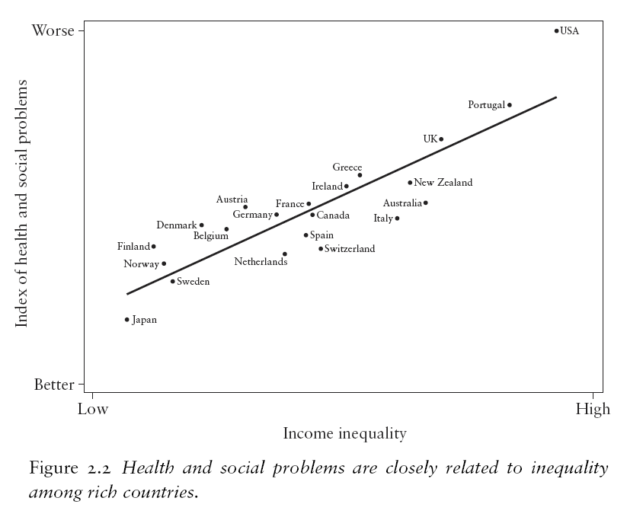
Used with permission, Wilkinson 2009
Notes:
This graph shows the affect of income inequality in relationship to health. Look at the upper right hand corner of the graph—United States of America appears. It has a high income inequality and it also has the worst health and the relationship between income inequality and health increases: the more inequality the worse the health, the less inequality, the better the health. We can see countries such as Finland, Norway, and Sweden, in which there is less income inequality; have a better index of health.

Slide 39
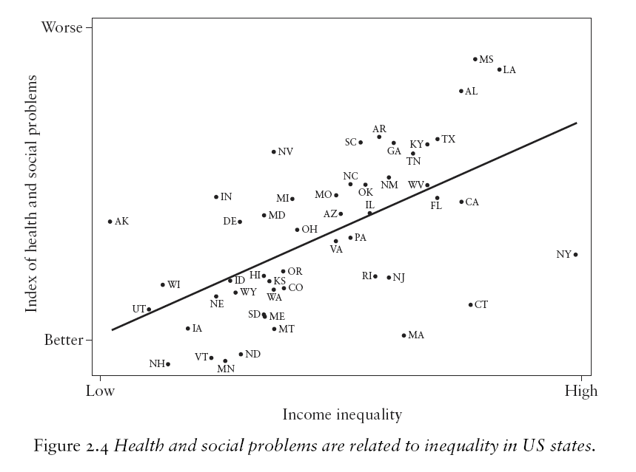
Used with permission, Wilkinson 2009
Notes:
It’s also interesting that we can see the same relationship between income inequality and health in various states throughout our nation. So, states with high income inequality have worse health and social problems. Mississippi, Louisiana, Alabama, and New York on the right side of the graph have high income inequality and also have poor health indices.

Slide 40
Socioeconomic Factors and Disparity
The problems in rich countries are not caused by the society not being rich enough (or even by being too rich) but by the scale of material differences between people within each society being too big.
What matters is where we stand in relation to others in our own society.
Wilkinson 2009
Notes:
The problems in rich countries are not caused by the society not being rich enough, but by the scale of material differences between people within each society. What matters is where we stand in relation to others in our own society.

Slide 41
Socioeconomic Factors and Disparity
In and around Washington DC, the gap is bigger still—a 20 year gap between poor Blacks in downtown Washington and well-off Whites in Montgomery County, Maryland, a short metro ride away.
Marmot 2006
Notes:
In and around Washington, DC, there is a large gap, a 20 year gap between poor African Americans and well-off Whites in Montgomery County, Maryland, a short metro ride away.

Slide 42
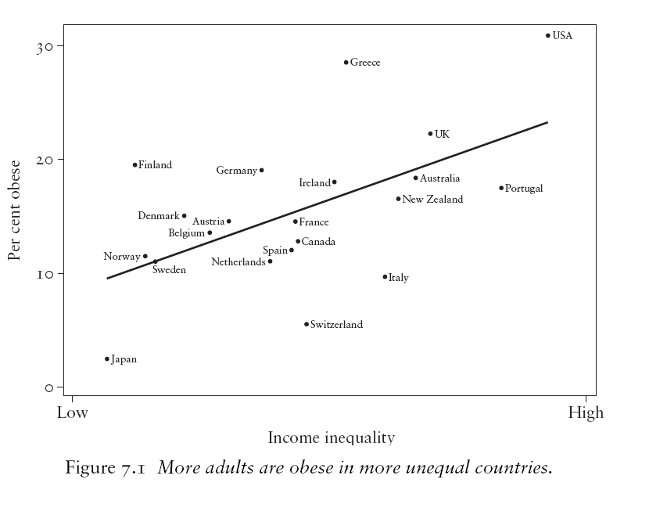
Used with permission, Wilkinson 2009
Notes:
This graph gives a possible clue to the influence of income inequality on health. Again, the USA appears in the upper right-hand corner. This graph shows that the percent of the population that is obese, increases with increasing income inequality and again, on the left side of the graph with lower income inequality, countries such as Norway, Sweden, Denmark, and Finland have lower percentages of individuals who are obese.

Slide 43
Socioeconomic Factors and Disparity
Above a level where material deprivation is no longer the main issue, absolute income is less important than how much one has relative to others.
Relative income is important because, it translates into capabilities.
What is important is not so much what you have but what you can do with what you have. Hence control and social engagement.
Marmot 2006
Notes:
Above the level where material deprivation is no longer the main issue, absolute income is less important than how much one has relative to others. What is important is not so much what you have but what you can do with what you have. Hence control and social engagement are thought to be important to health status.

Slide 44
Determinants of Health
Environment
Novick, LF. Used with permission.
Notes:
Returning to our diagram, we will briefly examine environmental factors.

Slide 45
Environmental Quality
Hazardous Wastes
Air Pollution
Water Pollution
Ambient Noise
Residential Crowding
Housing Quality
Educational Facilities
Work Environments
Neighborhood Quality
Lee, et. al 2003
Notes:
These include hazardous wastes, air pollution, water pollution, noise, crowding, housing quality, work environments and neighborhood quality. All of these are important to the health of the individual.

Slide 46
Determinants of Health
Biology
Novick, LF. Used with permission.
Notes:
Returning back to our diagram, we will now look at some biological influences on health.

Slide 47
Behavior
Modifiable behavioral risk factors are leading causes of mortality in the United States.
Mokdad et al. 2004
Notes:
Modifiable behavioral risk factors are leading causes of mortality in the United States.

Slide 48
Other Important Causes
Microbial Agents
Toxic Agents
Motor Vehicles
Firearms
Sexual Behavior
Illicit Use of Drugs
Mokdad et al. 2004
Notes:
Important underlying causes, in addition to smoking, are microbial agents, toxic agents, motor vehicles, firearms, sexual behavior, and illicit use of drugs.

Slide 49
Actual Causes of Death in the United States in 2000
Actual Cause |  |  | No. (%) in 2000
Tobacco |  |  | 435 000 | (18.10)
Poor diet and physical inactivity |  |  | 365 000 | (15.20)
Alcohol consumption** |  |  | 85 000 | (3.50)
Microbial agents |  |  | 75 000 | (3.10)
Toxic agents |  |  | 55 000 | (2.30)
Motor vehicle |  |  | 43 000 | (1.80)
Firearms |  |  | 29 000 | (1.20)
Sexual behavior |  |  | 20 000 | (0.80)
Illicit drug use |  |  | 17 000 | (0.70)
Total |  |  | 1 159 000 | (48.20)
*Data are from McGinnis and Foege. The percentages are for all deaths.
**In 2000 data, 16,653 deaths from alcohol-related crashes are included in both alcohol Consumption and motor vehicle death categories.
Used with permission, Mokdad et al. 2004
Notes:
This chart comes from a study by McGinnis and Foege and it shows the actual causes of death—causes related to our behaviors, to risk factors, not the diagnosis that appear on the death certificate and as we look at this chart, we see the prominent role of tobacco, now closely followed by poor diet and physical activity and then a host of other behavioral factors from substance abuse to motor vehicle use and sexual behavior.

Slide 50
Behavior
The burden of chronic diseases is compounded by the aging effects of the baby boomer generation and the concomitant increased cost of illness at a time when health care spending continues to outstrip growth in the gross domestic product of the United States.
Mokdad et al. 2004
Notes:
The burden of chronic diseases is compounded by the aging effects of the baby boomer generation and the concomitant increased cost of illness at a time when health care spending continues to outstrip growth in the gross domestic product of the United States.

Slide 51
Smoking and Obesity
Although there is still much to do in tobacco control, it is nevertheless touted as a model for combating obesity, the other major, potentially preventable cause of death and disability in the United States.
Smoking and obesity share many characteristics.
Schroeder 2007
Notes:
Although there is still much to do in tobacco control, it is nevertheless touted as a model for combating obesity, the other major, potentially preventable cause of death and disability in the United States. Smoking and obesity share many characteristics.

Slide 52
Smoking and Obesity
are highly prevalent
start in childhood or adolescence
were relatively uncommon until the first (smoking) or second (obesity) half of the 20th century
are major risk factors for chronic disease
involve intensively marketed products
are more common in low socioeconomic classes
exhibit major regional variations (with higher rates in southern and poorer states)
carry a stigma
are difficult to treat
are less enthusiastically embraced by clinicians than other risk factors for medical conditions
Schroeder 2007
Notes:
They are highly prevalent, they start early in life, they are major risk factors for chronic disease, they involve intensively marketed products, they are more common in lower socioeconomic classes, they carry a stigma, and they are difficult to treat.

Slide 53
Lifestyle
Personal behaviors play critical roles in the development of many serious diseases and injuries.
Behavioral factors largely determine the patterns of disease and mortality of the twentieth-century populations of the United States.
US Department of health, Education and Welfare, Breslow 1998
Notes:
Personal behaviors, as we’ve been discussing, play critical roles in the development of many serious diseases and injuries. Behavioral factors largely determine the patterns of disease and mortality of the 20th century and now 21st century populations of the United States.

Slide 54
Fifth Phase of the Epidemiologic Transition
The Age of Obesity and Inactivity
Gaziano 2010
Notes:
We can be said to be in the fifth phase of the epidemiologic transition. The first stage, we discussed was seen in the early 20th century and in the 19th century. It was characterized by infectious disease. Further stages were characterized by chronic disease. We are now in the fifth phase, characterized by obesity and inactivity.

Slide 55
Fifth Phase of the Epidemiologic Transition
The steady gains made in both quality of life and longevity by addressing risk factors such as smoking, hypertension, and dyslipidemia are threatened by the obesity epidemic.
The latest prevalence and trends in obesity data from the National Health and Nutrition Examination Survey (NHANES), reported by Flegal and colleagues, show that in 2007-2008, 68.0% of US adults were overweight, of whom 33.8% were obese.
Gaziano 2010
Notes:
And this obesity epidemic is threatening the steady gains we have made in quality of life and longevity by addressing risk factors such as smoking, hypertension, and dyslipidemia. The latest prevalence and trends in obesity data, reported by Flegal and colleagues, show that in 2007-2008, 68% of US adults were overweight, of whom 33.8% were obese.

Slide 56
Fifth Phase of the Epidemiologic Transition
Early obesity strongly predicts later cardiovascular disease, and excess weight may explain the dramatic increase in type 2 diabetes, a major risk factor for cardiovascular disease.
The longer the delay in taking aggressive action, the higher the likelihood that the significant progress achieved in decreasing chronic disease rates during the last 40 years will be negated, possibly even with a decrease in life expectancy.
Gaziano 2010
Notes:
Early obesity strongly predicts later cardiovascular disease and excess weight may explain the dramatic increase in Type II diabetes, a major risk factor in cardiovascular disease. The longer the delay in taking aggressive action, the higher the likelihood that significant progress achieved in decreasing the chronic disease rates during the last 40 years, will be negated, possibly even with a decrease in life expectancy. This is important because for the first time, a current generation may live less years than the preceding generation, their parents.

Slide 57
Fifth Phase of the Epidemiologic Transition
More men than women were overweight or obese, 72.3% compared with 64.1%.
If left unchecked, overweight and obesity have the potential to rival smoking as a public health problem, potentially reversing the net benefit that declining smoking rates have had on the US population over the last 50 years.
Gaziano 2010
Notes:
More men than women were overweight or obese, 72% as compared to 64%. Again, if left unchecked, overweight and obesity have the potential to rival smoking as a public health problem, potentially reversing the net benefit that declining smoking rates have had on the US population over the last 50 years.

Slide 58
Medical Care as a Determinant
Inadequate health care may account for 10% of premature death
Health care receives by far the greatest share of our resources and attention.
Notes:
Now, let’s look at medical care as a determinant. Inadequate health care may account for 10% of premature death, but is paradoxical that health care receives by far the largest share of our resources and attention, although it does not account for as much premature death as the other factors or determinants we have discussed so far.

Slide 59
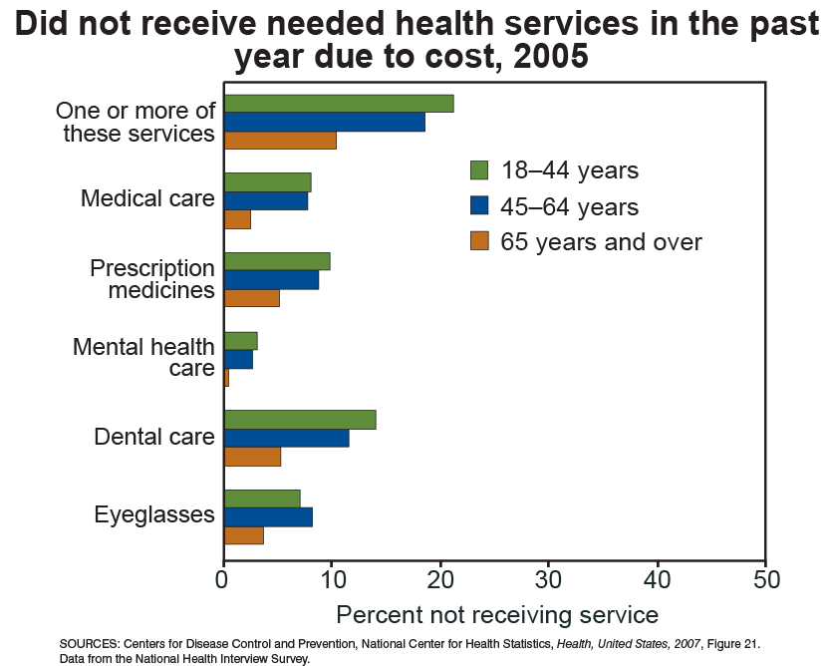
Notes:
Let’s look at this graph, it shows those who did not receive needed health services in the past year due to cost. The largest age group that did not receive needed health services were those that were 18 to 44 years of age, probably because of the fact that this group is more likely to be uninsured. The group that is the smallest in not receiving needed health services is the group 65 years and over, shown by the brown bars on the graph. This is probably related to the fact that this group is covered by Medicare.

Slide 60
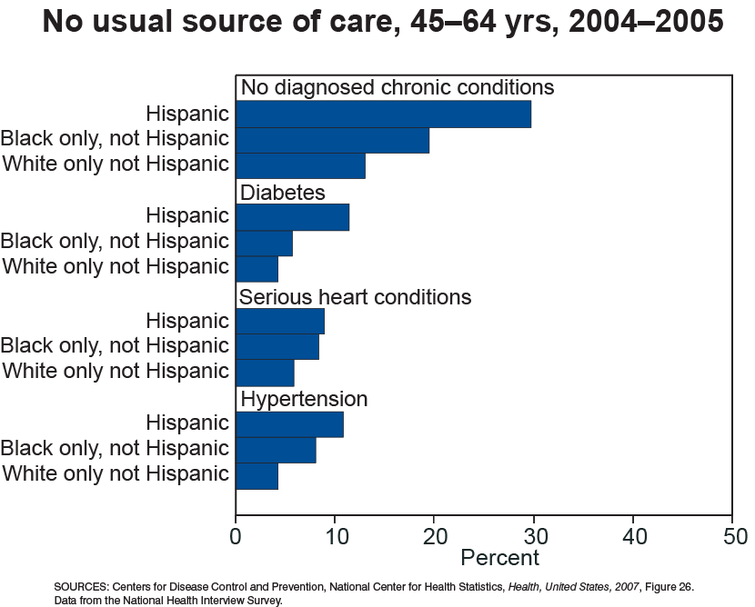
Notes:
The next graph shows individuals without a usual source of care. Adults aged 45-64 years. We see here that minorities dominate in not having a usual source of care, and this is true for those diagnosed with chronic diseases, diabetes, serious heart conditions and hypertension, as well as those not diagnosed with chronic heart disease.

Slide 61
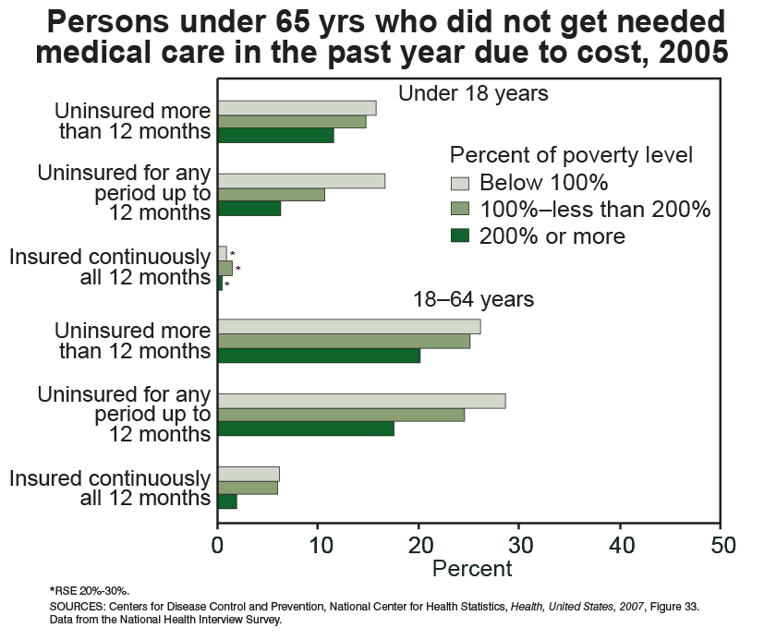
Notes:
And finally, this graph shows persons under 65 years who did not get needed medical care due to cost, and as we would expect, the group that is largest in this regard is the group that is uninsured and the group that is below the poverty line.

Slide 62
Medical Care as a Determinant
Missing routine or preventive medical care can lead to the need for emergency care or even to preventable hospitalizations.
Lack of access to transportation due to not owning a vehicle, not having a vehicle available via a friend or family member, or not having access to public transportation can lead to difficulty in seeking medical care.
National Center for Health Statistics Health, United States, 2008 With Chartbook Hyattsville, MD: 2009
Notes:
Missing routine or preventive medical care can lead to the need for emergency care or even to preventable hospitalizations. Lack of access to transportation due to not owning a vehicle, not having a vehicle available via a friend or family member, or not having access to public transportation can lead to difficulty in seeking medical care.

Slide 63
Population Health Challenges
Preventable chronic illnesses
Obesity epidemic
Unsustainable health care delivery system
Maeshiro 2008
Notes:
The population health challenges we face include preventable chronic illnesses, an obesity epidemic, an unsustainable health care delivery system because of its escalating cost and its limited impact on the health status of populations.

Slide 64
Population Based Prevention
The fundamental principle is that health of the community is dependent on many factors affecting an entire population.
Thus the target for public health interventions should be a geographic or otherwise defined population.
Notes:
The fundamental principle of population based prevention is that the health of the community is dependent on many factors affecting an entire population. These are the factors that we have been discussing. Thus, the target for public health interventions should be a geographic or otherwise defined population.

Slide 65
Population Based Prevention
Because of the broad distribution of most diseases and health determinants, using a population as an organizing principle for preventive action has the potential to have a great impact on the entire population’s health.
It takes partnering at all levels to fully realize the impact of any health intervention.
Notes:
Because of the broad distribution of most diseases and health determinants, using population as an organizing principle for preventive action has great potential to have a significant impact on the entire population’s health. It takes partnering at all levels to fully realize the impact of any health intervention.

Slide 66
Population Based Prevention
Population-based and individual-targeted preventive strategies must be considered to be complementary, not exclusive.
Comprehensive population-based prevention strategies may involve screening programs for individuals, for example, newborn screening for metabolic diseases, childhood lead testing, colorectal cancer screening, mammography, and pap smears.
Notes:
Population-based and individual-targeted preventive strategies must be considered to be complementary, not exclusive.

Slide 67
Healthy People
In 1979, Healthy People marked a turning point in the approach and strategy for public health in the United States.
The key to Healthy People was the premise that the personal habits and behaviors of individuals determined “whether a person will be healthy or sick, live a long life or die prematurely.”
US Department of Health, Education and Welfare 1979
Notes:
In 1979, Healthy People marked a turning point in the approach and strategy for public health in the United States. The key to Healthy People was the premise that the personal habits and behaviors of individuals determined whether a person will be healthy or sick, live a long life or die prematurely.

Slide 68

Cover of 1979 edition of Healthy People
Notes:
This is the cover of the 1979 edition of Healthy People, the Surgeon General’s report on health promotion and disease prevention.

Slide 69

Letter from Jimmy Carter from 1979 Healthy People
Notes:
This is the letter from Jimmy Carter that accompanied the 1979 Healthy People document. While the slide may be difficult to read, I want to read some excerpts from this letter. “We Americans are healthier today than we have ever been. Our understanding of the causes of health problems has grown enormously, and with it our ability to prevent and treat illness and injury. I have long advocated a greater emphasis on preventing illnesses and injury by reducing environmental and occupational hazards and by urging people to choose to lead healthier lives. So I welcome this Surgeon General’s Report on Health Promotion and Disease Prevention. It sets out a national program for improving the health of our people—a program that relies on prevention along with cure.”

Slide 70
What is Healthy People?
National agenda that communicates a vision and overarching goals, supported by topic areas and specific objectives for improving the population’s health and achieving health equity.
Slade-Sawyer, P, HHS Office of Disease Prevention and Health Promotion
Notes:
Healthy People sets forth a national agenda with two specific goals—improving the population’s health and achieving health equity or reducing health disparities.

Slide 71
Healthy People
The report urged Americans to adopt simple measures to enhance health including:
  elimination of cigarette smoking
  reduction of alcohol misuse
  moderate dietary changes to reduce the intake of excess calories, fat, salt, and sugar
  moderate exercise
  periodic screening (at intervals to be determined by age and sex) for major disorders such as high blood pressure and certain cancers
  adherence to speed laws and the use of seat belts
US Department of Health, Education and Welfare 1979
Notes:
The report urged Americans to adopt simple measures to enhance health including elimination of cigarette smoking, reduction of alcohol misuse, improving diet, increasing exercise, periodic screening at intervals to be determined by age and sex, and adherence to speed laws and use of seat belts.

Slide 72
Healthy People
A major thrust of the report was a focus on age-related risk.
The health problems that affect children change in adolescence and early adulthood and again in old age. At each stage in life, there are different problems and different preventive actions.
US Department of Health, Education and Welfare 1979
Notes:
A major thrust of the report was a focus on age-related risk. The health problems that affect children change in adolescence and early adulthood and again in old age. At each stage in life, there are different problems and different preventive actions.

Slide 73
Healthy People
Accidents and violence predominate in adolescence; chronic disease is the major problem in later adulthood and old age. Public health program planning must be attuned to the age-specific diversity of health problems.
Healthy People set out five age-specific goals in 1977.
US Department of Health, Education and Welfare 1979
Notes:
Accidents and violence predominate in adolescence; chronic disease is the major problem in later adult and old age. Healthy People set out five age-specific goals in 1977.

Slide 74
Healthy People
These goals with specific objectives were reformulated by a second report issued by the surgeon general in the fall of 1980.
Promoting Health/Preventing Disease: Objectives for the Nation established quantifiable objectives to reach the broad goals of Healthy People.
This objective-based population preventive strategy continues today with the Healthy People 2020 objectives
US Department of health and Human Services 1980
Notes:
These goals with specific objectives were reformulated in a second report issued by the Surgeon General in the fall of 1980.

Slide 75




Evolution of Healthy People
Target Year | 1990 | 2000 | 2010 | 2020
OverarchingGoals | Decrease mortality: infants-adults Increase independence among older adults | Increase span of healthy life Reduce health disparities Achieve access to preventive services for all | Increase quality and years of healthy life Eliminate health disparities | Attain high quality, longer lives free of preventable disease… Achieve health equity, eliminate disparities… Create social and physical environments that promote good health… Promote quality of life, healthy development, healthy behaviors across life stages…
Topic Areas | 15 | 22 | 28 | 42*
# Objectives | 226 | 312 | 467 | > 580
*39 Topic areas with objectives
Slade-Sawyer, P, HHS Office of Disease Prevention and Health Promotion
Notes:
And for each successive decade, we have had a Healthy People document, spelling out the nation’s agenda to improve health. And the number of objectives has grown with each document, so there were 226 in 1990 and in Healthy People 2020, nearly 600.

Slide 76
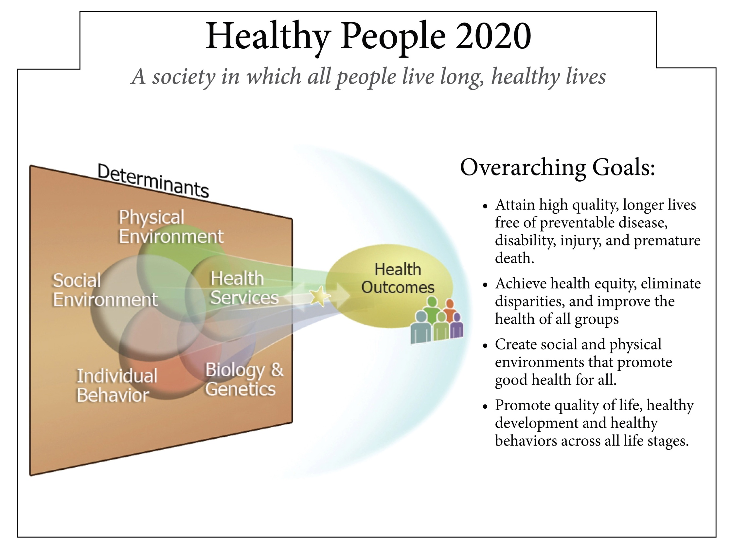
Slade-Sawyer, P, HHS Office of Disease Prevention and Health Promotion
Notes:
The overarching goal of Healthy People 2020 is to attain high quality, long lives free of preventable disease, with a reduction in premature death and the second goal to achieve health equity, eliminating disparities and improving the health of all groups.

Slide 77
Healthy People 2020: Framework
Mission—Healthy People 2020 strives to:
  Identify nationwide health improvement priorities
  Increase public awareness and understanding of the determinants of health, disease, and disability and the opportunities for progress
  Provide measurable objectives and goals that are applicable at the national, state, and local levels
  Engage multiple sectors to take actions to strengthen policies and improve practices that are driven by the best available evidence and knowledge
  Identify critical research, evaluation, and data collection needs.
Slade-Sawyer, P, HHS Office of Disease Prevention and Health Promotion
Notes:
Healthy People 2020 strives to identify national health improvement priorities. Healthy people 2020 strives to identify nationwide health improvement priorities and to provide measurable objectives and goals that are applicable to national, state, and local levels. This will require a partnership engaging multiple sectors to take actions to proceed along this agenda, improving practices that are driven by the best available evidence and knowledge.

Slide 78
Summary
Successful health promotion depends on a population-based strategy of prevention
Common diseases have roots in lifestyle, social factors, and environmental determinants
Determinants which have the most influence on health: environment, social factors, biology
Americans live longer with less ill health or premature death but gains are not shared equally by all members of society
Notes:
Let’s summarize what we have been discussing in this presentation. Successful health promotion depends on a population-based strategy of prevention. Common diseases have roots in lifestyle, social factors, and environmental determinants. Determinants which have the most influence on health are environment, social factors, and biology. Americans live longer with less ill health or premature death, but these gains are not shared equally by all members of society.

Slide 79
Summary
Elevated death rates for the poor are evident in almost all causes of death
Modifiable behavioral risk factors are leading causes of mortality in the US
Because of the broad distribution of determinant impacts on health, addressing populations will have great impact
Notes:
Elevated death rates for the poor are evident in almost all causes of death. Modifiable behavioral risk factors are leading causes of mortality in the United States. Most important, because of the broad distribution of determinants and their impact on health, addressing populations will have the greatest impact in the future in improving the health of our population, our communities, and also the health of individuals.

Slide 80
Collaborating Institutions
Center for Public Health Continuing Education
University at Albany School of Public Health
Department of Community & Family Medicine
Duke University School of Medicine

Slide 81
Advisory Committee
Mike Barry, CAE
Lorrie Basnight, MD
Nancy Bennett, MD, MS
Ruth Gaare Bernheim, JD, MPH
Amber Berrian, MPH
James Cawley, MPH, PA-C
Jack Dillenberg, DDS, MPH
Kristine Gebbie, RN, DrPH
Asim Jani, MD, MPH, FACP
Denise Koo, MD, MPH
Suzanne Lazorick, MD, MPH
Rika Maeshiro, MD, MPH
Dan Mareck, MD
Steve McCurdy, MD, MPH
Susan M. Meyer, PhD
Sallie Rixey, MD, MEd
Nawraz Shawir, MBBS

Slide 82
APTR
Sharon Hull, MD, MPH
President
Allison L. Lewis
Executive Director
O. Kent Nordvig, MEd
  Project Representative

